Slide 1


Fake News Detection using Machine Learning
By
Santosh Omprakash

Slide 2
Contents
Problem statement
Proposal
Data Preprocessing
Natural Language Processing (NLP)
Exploratory Data Analysis (EDA)
Model Selection and Evaluation
Results
Conclusion

Slide 3
Problem Statement
Fake news is the intentional misrepresentation of news
With the advent of online platforms and smart phones, news can be accessed easily
Motive behind fake news is to mislead readers and harm reputation of individual or institution
Posts and images about un-verified news circulated via social media are believed to be accurate

Slide 4
Proposal
Fake news should be detected at early stage before it is widely spread
Fake news can be detected using Machine Learning Algorithms
The news dataset will be analyzed to detect whether it is reliable or un-reliable (fake)
The prediction model can be used in website to detect fake news and prevent them

Slide 5
Data preprocessing
The news dataset is selected from Kaggle
The variables in the dataset are –
ID
Title
Author
Text
Label
The dataset is processed to remove null values
Variables auth and text are combined for text processing

Slide 6
Natural Language Processing (NLP)
NLP is used to convert text to help computer understand human natural language
Python library Natural Language Toolkit (NLTK) is used
Text is converted to lower case
Special character and symbols are removed
Stop words are removed and stemming is performed

Slide 7
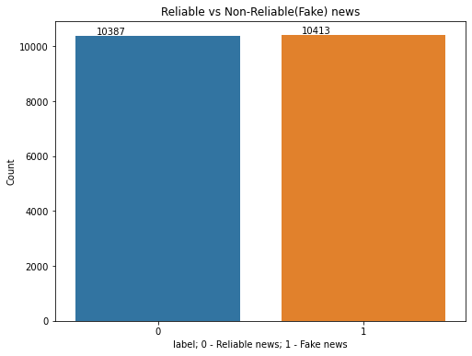
Exploratory Data Analysis (EDA)
Target variable ‘label’ is visualized
Dataset is balanced with almost equal records for reliable and fake news

Slide 8
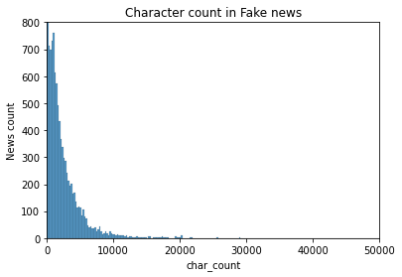
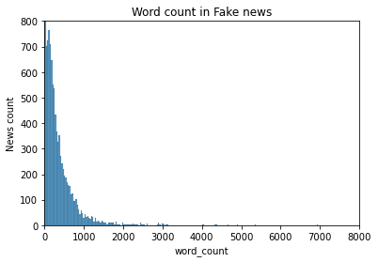
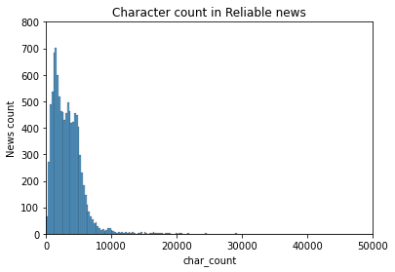
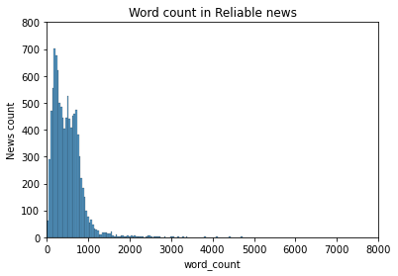
EDA
Graph of character count and word count are plotted
Fake news have fewer words and are shorter compared to reliable news

Slide 9
Outliers
The character count is analyzed to check for outliers
The minimum character count is 0 and maximum character count is 79,346
Records with character less than 45 are removed from processing

Slide 10
Model Selection and Evaluation
Term Frequency-Inverse Document Frequency (TF-IDF) is used for vectorization
Metric used for model selection is for models is ROC-AUC (Receiver Operating Characteristic Area Under Curve)
Dataset is split into train and test – 80% for training and 20% for testing

Slide 11
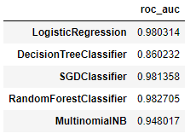
Model Selection and Evaluation
Train data was fit with five models
Random Forest model has best score of 98.27
It was selected for tuning

Slide 12
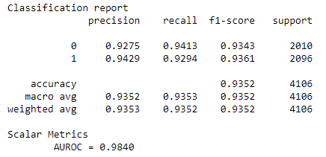
Model Selection and Evaluation
Hyperparameter tuning is performed on Random Forest model
Grid Search CV method is used
Model score increased to 98.40%

Slide 13
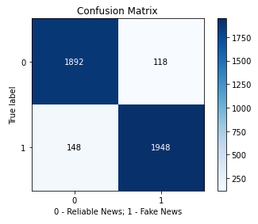
Results
Confusion matrix of tuned model is shown
True positive rate is 94.28%
True Negative rate is 92.74%

Slide 14
Conclusion
The project focus is to detect fake news using machine learning algorithms
Random Forest model is used for detection
The model can be used with applications and website for automatic detection

Slide 15
Thank you

